Slide 1
Breaking the RESTraints: Building flexible APIs with GraphQL
Yoanna Atanasova

Slide 2
A bit about me:
Technical Team Lead of a .Net + Angular Team
Main experience with C#
Experience with Angular and React
Working with GraphQL for the last 2 years

Slide 3
My experience with GraphQL
Developing .Net +Angular application
Sending requests from our SPA client to retrieve or update data
Many data management (CRUD operations)
Many grids and screens showing specific information
Complying with strict security requirements

Slide 4
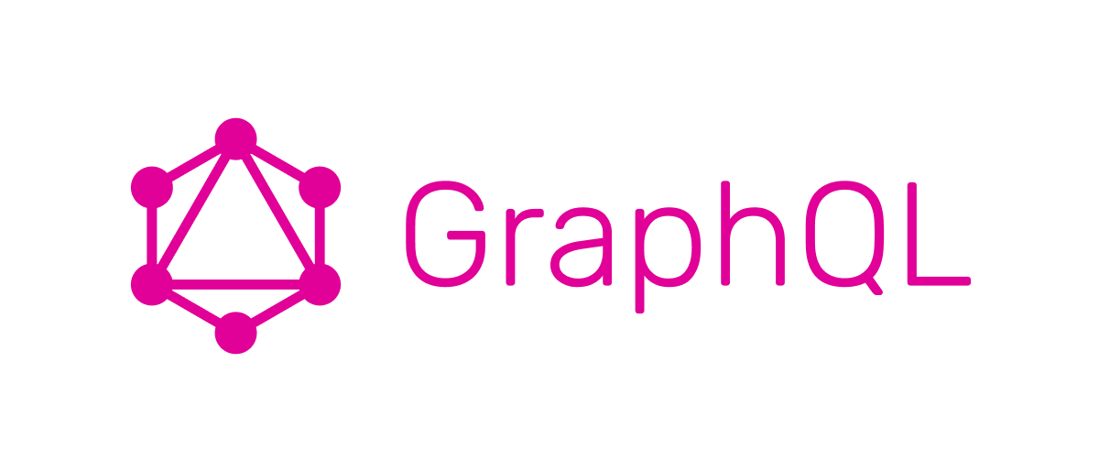
What is GraphQL?
Graph
QL
APIs are organized in terms of schemas (or graphs) and not endpoint
Is achieved by defining the structure of the data and its relationships
Schema Definition Language
Meaning Query Language
Main premise of is to allow clients to request only the data they need

Slide 5
GraphQL operations
Types of GraphQL operations:
Queries – used to retrieve data
Mutations – used to modify data
Subscriptions – used for real time updates
All requests in GraphQL are HTTP POST calls

Slide 6
DEMO

Slide 7
Querying Data
Overfetching and underfetching
Big problem in REST APIs
Fixed data sets – getting more information than the client wants or less

Slide 8
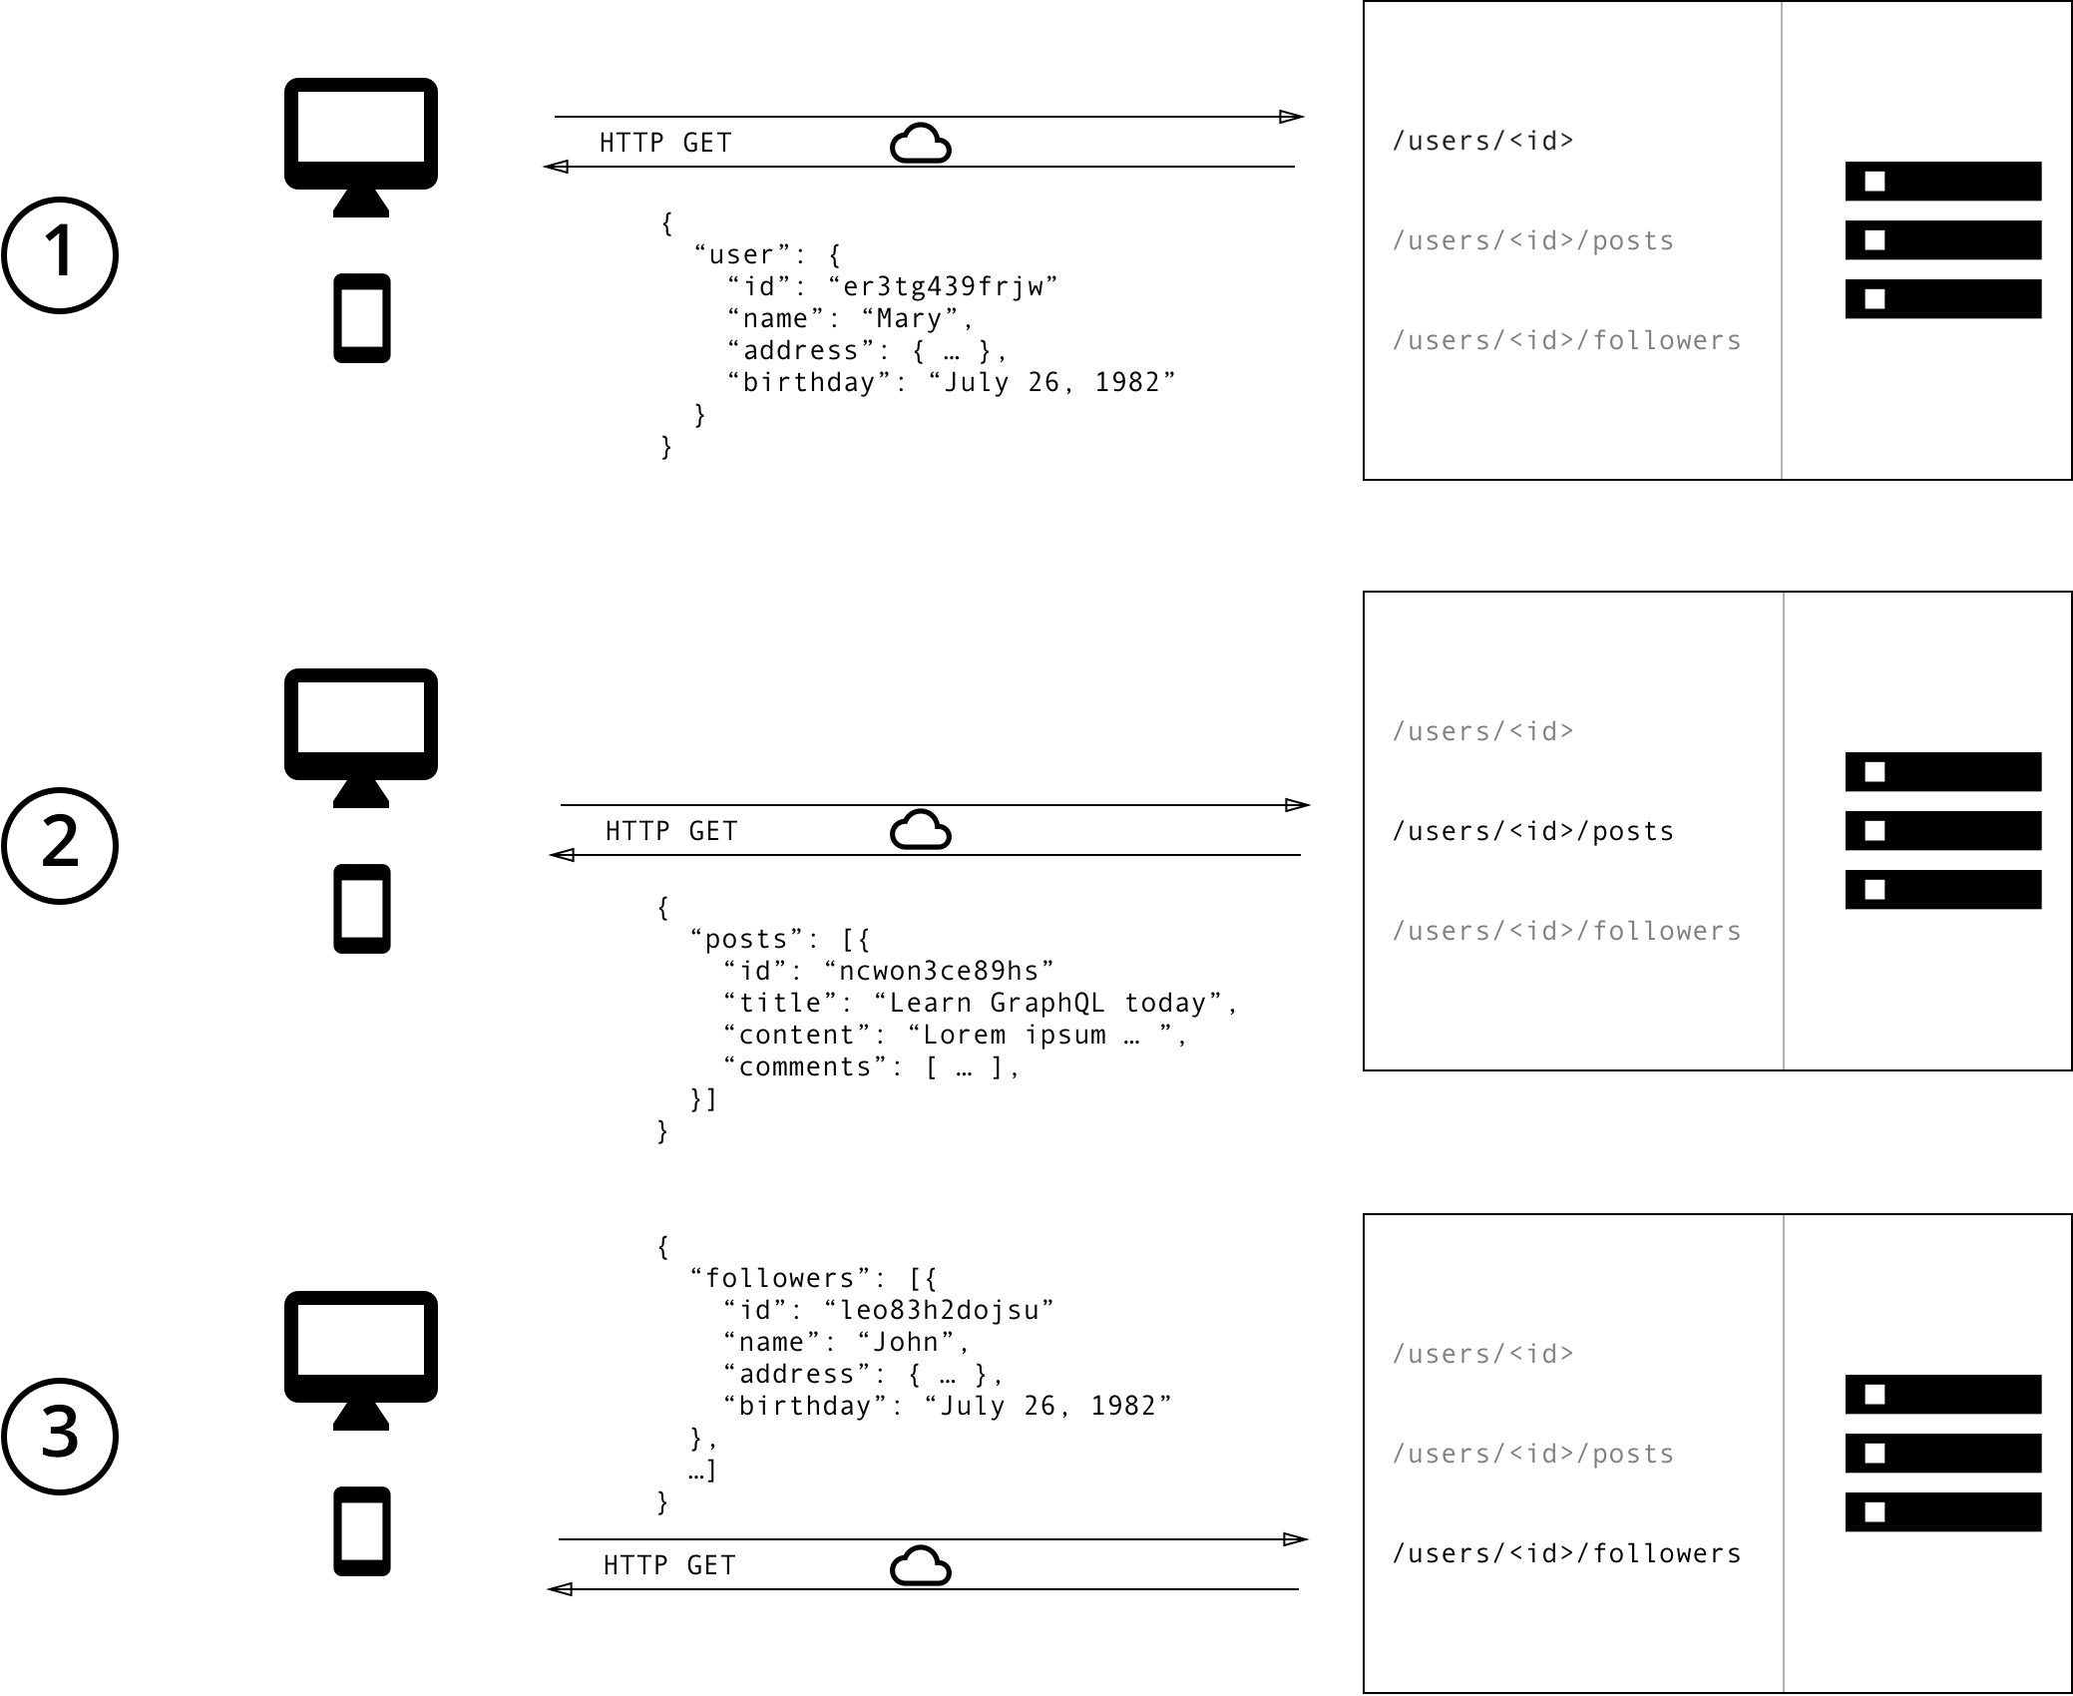
Querying Data
N+1 Problem
When extracting relational data, i.e. executing extra request to get what we want
Typically referenced for network requests
Can happen for DB requests as well
Source: https://www.howtographql.com/basics/1-graphql-is-the-better-rest/

Slide 9

Security
Standard Security Settings
Recommended Best Practices
Authentication
Authorization
Input Validation
Limit property exposure (consider explicit bindings)
Query depth Limiting
Query complexity limiting
Timeout
Rate limiting

Slide 10
Comparing GraphQL to REST and OData
 | GraphQL | REST | OData
Approach | Client-driven | Server-driven | Client/server-driven
Organized in terms of | Schema and type system | Endpoints | Endpoints
Operations | Query, mutation, subscription | CRUD | CRUD
Data fetching | Specific data based on single request | Fixed data, spread into multiple requests | Fixed data, spread into multiple requests
Performance | One network call | Multiple network calls can cost more time | Multiple network calls can cost more time
Self-documenting | Yes | No | No
File uploading | Supported in some libraries | Yes | Yes
Access Control | Fine-grained | General | General, but has options
Community | Growing comunity | Large community | Large community
Learning curve | A bit steeper | Easy | Relatively easy
Development speed | Faster | Slower | Slower

Slide 11
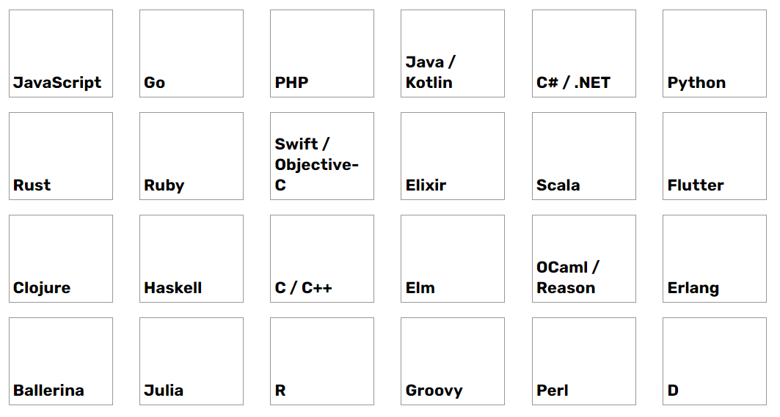
Community and libraries
Language Support

Slide 12

GraphQL for .Net/C#
HotChocolate
GraphQL Server for .NET
Easier to start for beginners
Easier to work with
Well documented

Slide 13

GraphQL Clients
Benefits of using GraphQL clients:
Response handling (declarative fetching)
Caching query results
Schema validations

Slide 14
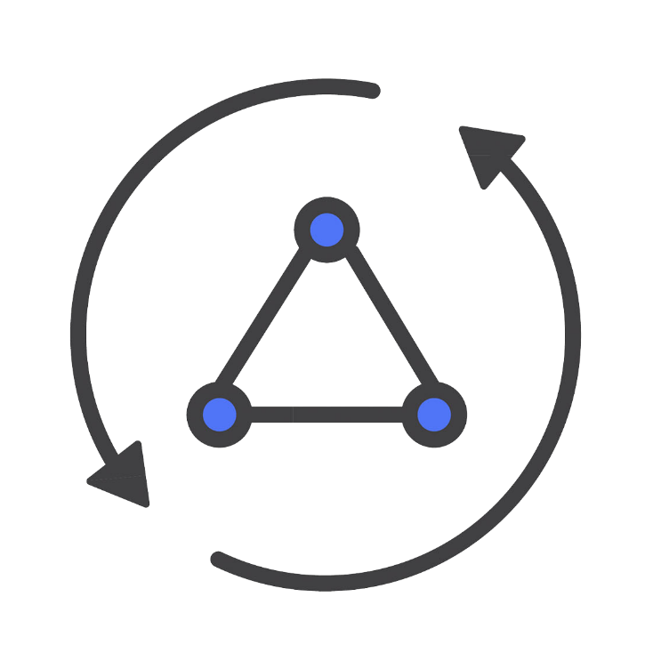



Serverless App Development
AWS AppSync
Cloud Functions for Firebase
Azure Functions
Hygraph

Slide 15
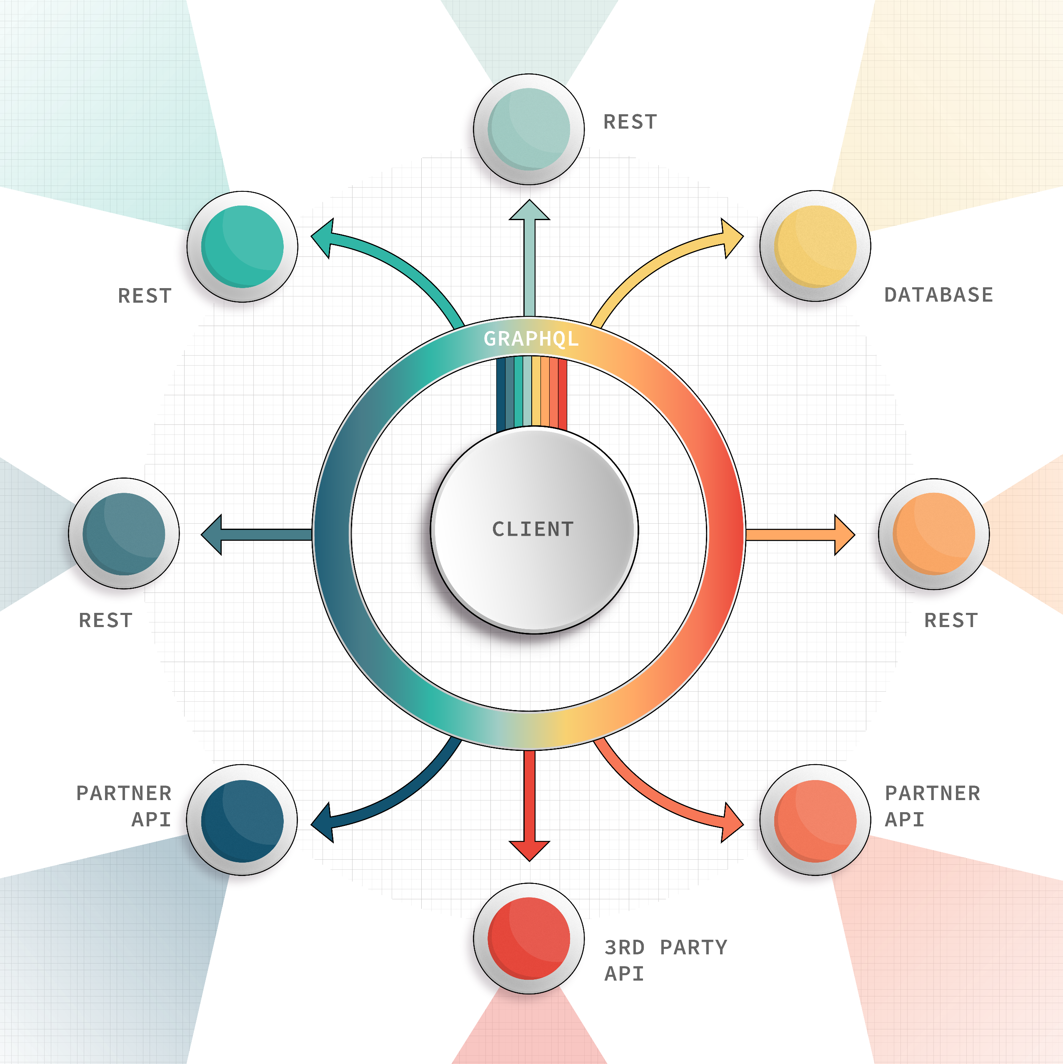
GraphQL vs REST
It’s GraphQL AND REST
GraphQL can help us elevate our REST apps
Create a common interface for all the data providers
Use them for what they do best
Source: https://graphql.com/learn/graphql-for-rest-devs/

Slide 16

Q&A
Yoanna Atanasova
y.atanasova@proxiad.com
www.linkedin.com/in/yoanna-atanasova

